Slide 1
Sprint 4 Presentation
Andrew Stepp, Brendan Cieslik, Yize Ma, Meihu Qin, Joe Prizlow, Connor Madek

Slide 2
Completed User Stories
As a user I need to be able to upload images of my locations’ floor plans.
As a user I need to be able to retrieve my floor plans for editing locations.
As a user, I will need to navigate the site using devices with different resolutions.
As a user, I need an easy to view grid system to assist in navigation.
Notes:
Connor

Slide 3
Next Sprint User Stories
As a user, I want to register my buildings and create my own maps by using tools provided by the website.
As a user, I want the UI to be easy for the users to understand.
As a user, I want to add details like room, hallways, and turning points to my maps precisely.
As a user, I want my work to be auto saved by the server when I quit.
As a user, I want to find the closest path to destination from a location that I choose.

Slide 4
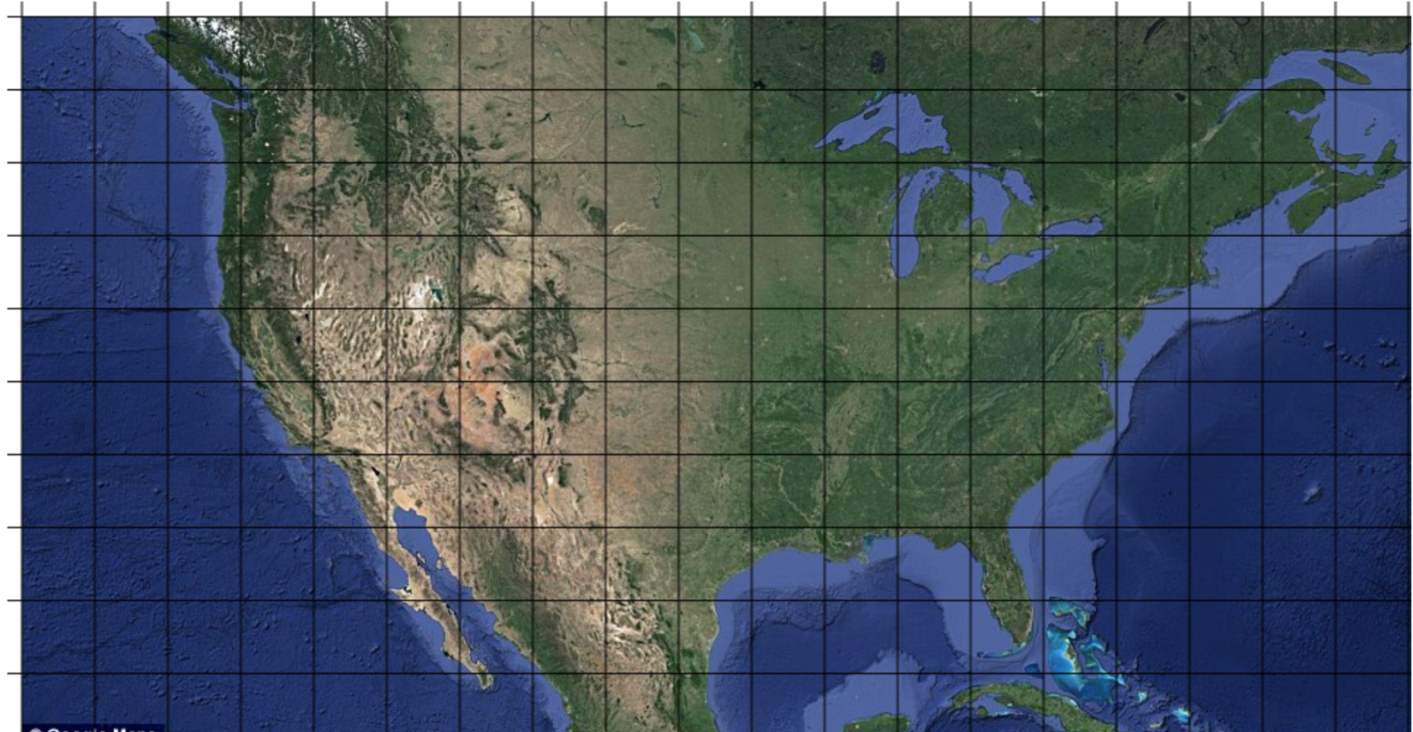
Image/Grid System
“As a user, I want to be able to take my uploaded image and view it on a grid system that will eventually host directions.”
Javascript to create a canvas that dynamically sizes based on the image passed to it (allows full flexibility with uploaded floor maps) and dynamically creates a grid system based on that image

Slide 5
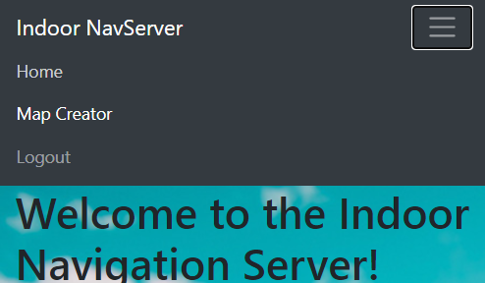
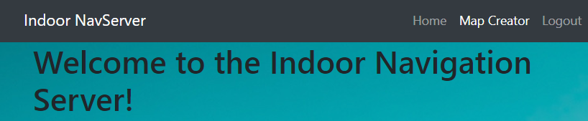
User Interface using Bootstrap
“As a user I need to navigate the site using devices with different resolutions”
Using bootstrap (A free and open-source CSS framework) we can make the elements of our website interactive and resizable allowing for easy navigation on any device.
Bootstrap can allow us to easily add moving elements utilizing javascript as well, which can be added in as we finalize the connections between our different resources and features.
Notes:
Brendan

Slide 6
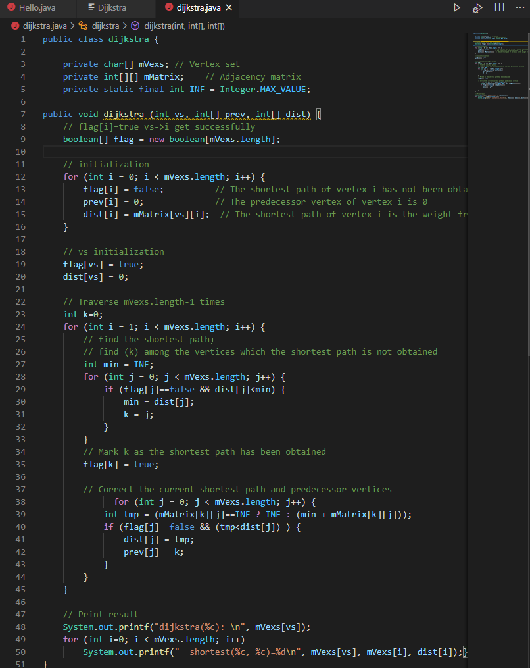
Dijkstra Algorithm
“As a user, I want to find the closest path to destination from a location that I choose.”
Using java abstract map into a directed graph
Using Dijkstra to find the shortest path between two vertices

Slide 7
Next Sprint Objectives
Create page for uploading Maps
Create page for viewing Map/grids
Make viewable the images from database on Website
Define building attributes

